Slide 1
AL English Literature Resource
Elizabethan Belief Systems

Slide 2
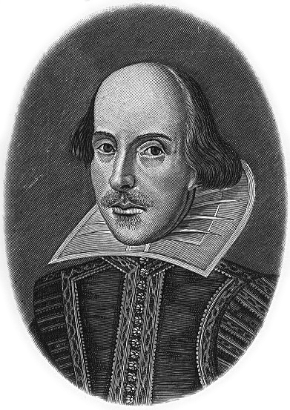
Key Contexts for Shakespeare’s Richard II Context 1: Elizabethan Belief Systems

Slide 3
Belief 1: The Importance of Hierarchy

Slide 4
Hierarchy and Status
In Elizabethan England, ideas of hierarchy and status underpinned people’s concept of society and the world.
Elizabethans believed that the whole universe was governed by divine will.
Nature was the instrument of God and the social hierarchy was a product of Nature.
It was therefore logical that subordination and unity were the natural rules to follow for the state, families and individuals.

Slide 5
An Ordered Society
In Elizabethan England, there was a big division between the rich and poor.
The aristocracy wielded social power over poorer people.
Women were seen as inferior to men.
Opportunities for social advancement were fairly limited.
The King (or Queen, in the case of Elizabeth I) was seen as being appointed by God.
This belief in the supremacy of the monarch is known as The Divine Right of Kings.

Slide 6
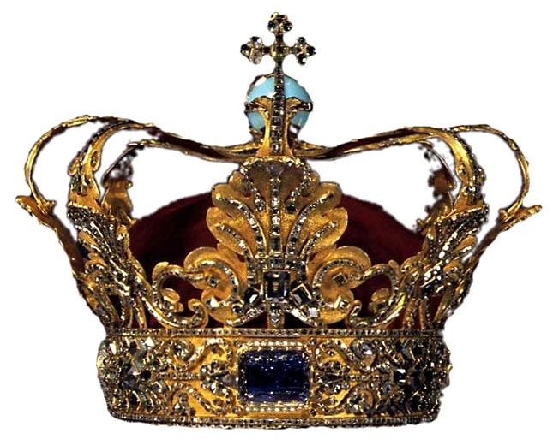
Belief 2: The Divine Right of Kings

Slide 7
The Divine Right of Kings
This was the belief that the monarch was appointed by God.
He/she was responsible only to God and not to his/her subjects or any earthly source.
A legitimate monarch is God’s deputy on earth.
Rebellion against the monarch is therefore a rebellion against God, and not just a crime against the King or Queen (treason) but a sin against God.
This is an extremely important context in Richard II, as the play debates the nature of Kingship. Richard’s view of himself is influenced by the Divine Right of Kings – and this concept influences our perception of Bolingbroke’s rebellion against Richard.

Slide 8
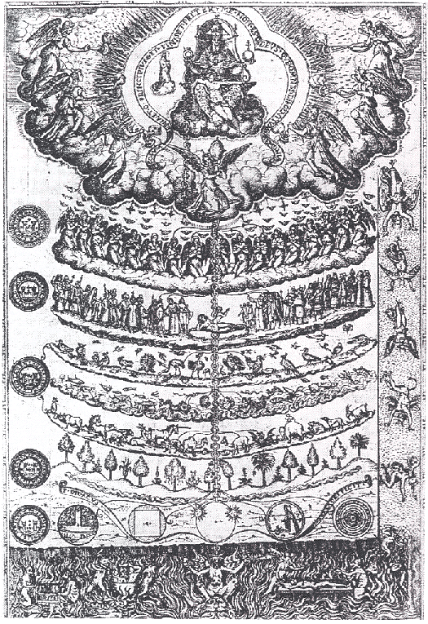
Belief 3:
The Great Chain of Being

Slide 9
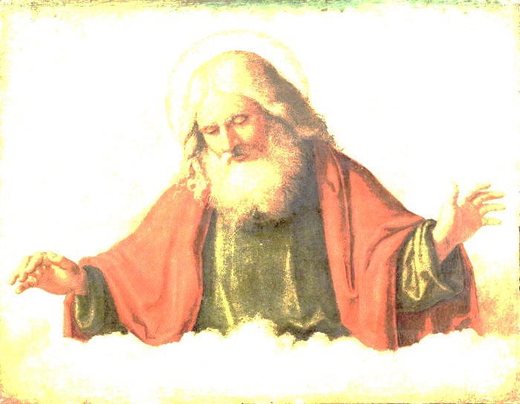
The Great Chain of Being
The Elizabethans believed in a strict hierarchy which underpinned society.
Everything and everyone had a place.
This hierarchy was connected to Christian belief, so God was at the top, and everything beneath Him also had a place – even down to rocks and minerals!
Because of the Divine Right of Kings, the monarch was seen as above all other men.
The attempt to move up this hierarchy, and/or to take the place of someone above you in the chain, is known as ‘usurpation’.
The Elizabethans believed that usurpation could lead to chaos, because it interrupted the natural order of the universe.

Slide 10
The Great Chain of Being: A Simplified Diagram
The Angels
The Planets
The King
Men
Women
Animals
Plants
God

Slide 11
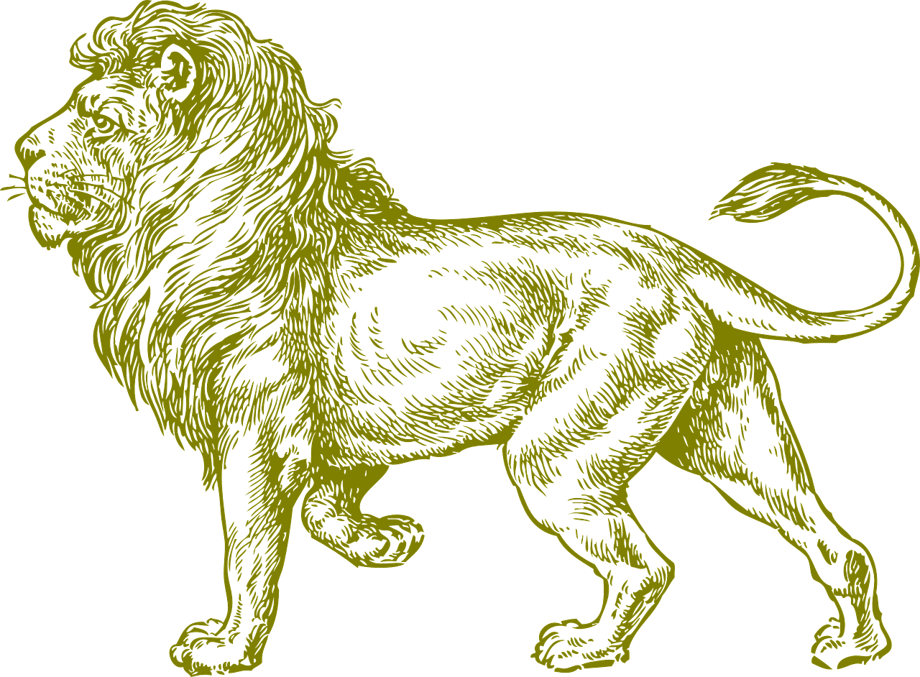
Hierarchies Within the Universe
These were similar to one another in a variety of ways:
God was head of the universe
The King/Queen was head of society
The lion was the king of the beasts
The eagle was the king of the birds
The sun was the head of the heavenly bodies.
Hierarchy therefore was fundamental to the Elizabethan worldview.
In Richard II you will see Richard equated with all of these things, as well as with God himself.

Slide 12
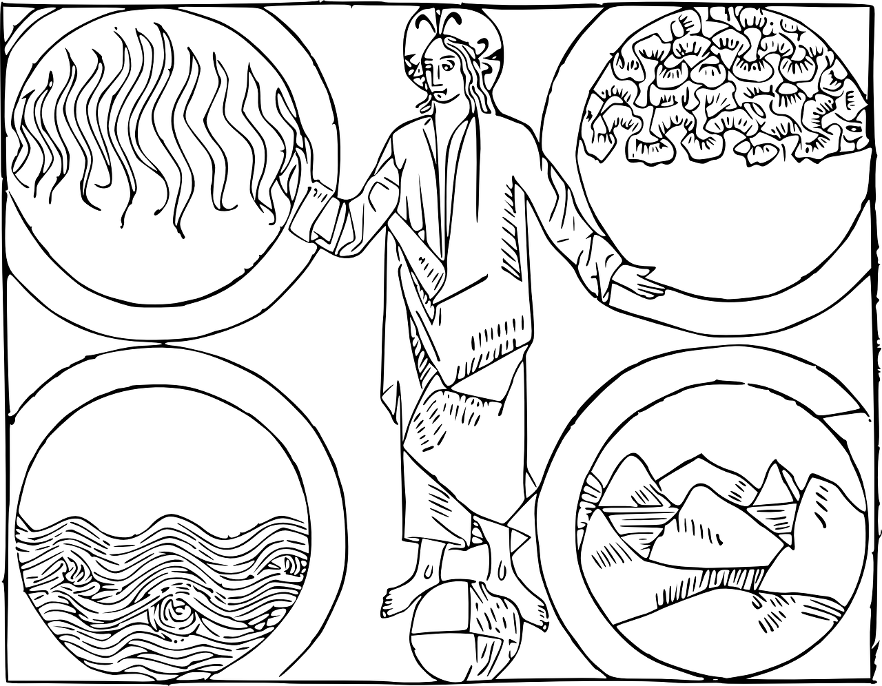
Belief 4:
The Four Elements

Slide 13
The Four Elements
The world was believed to be composed of four elements, also arranged hierarchically:
At the top: FIRE (the region of meteors)
Next: AIR
Followed by: WATER (the oceans)
And finally: EARTH (where man dwells – at the bottom)
The heavens are above this, composed of a fifth element: ETHER – this is perfect and unchanging..

Slide 14
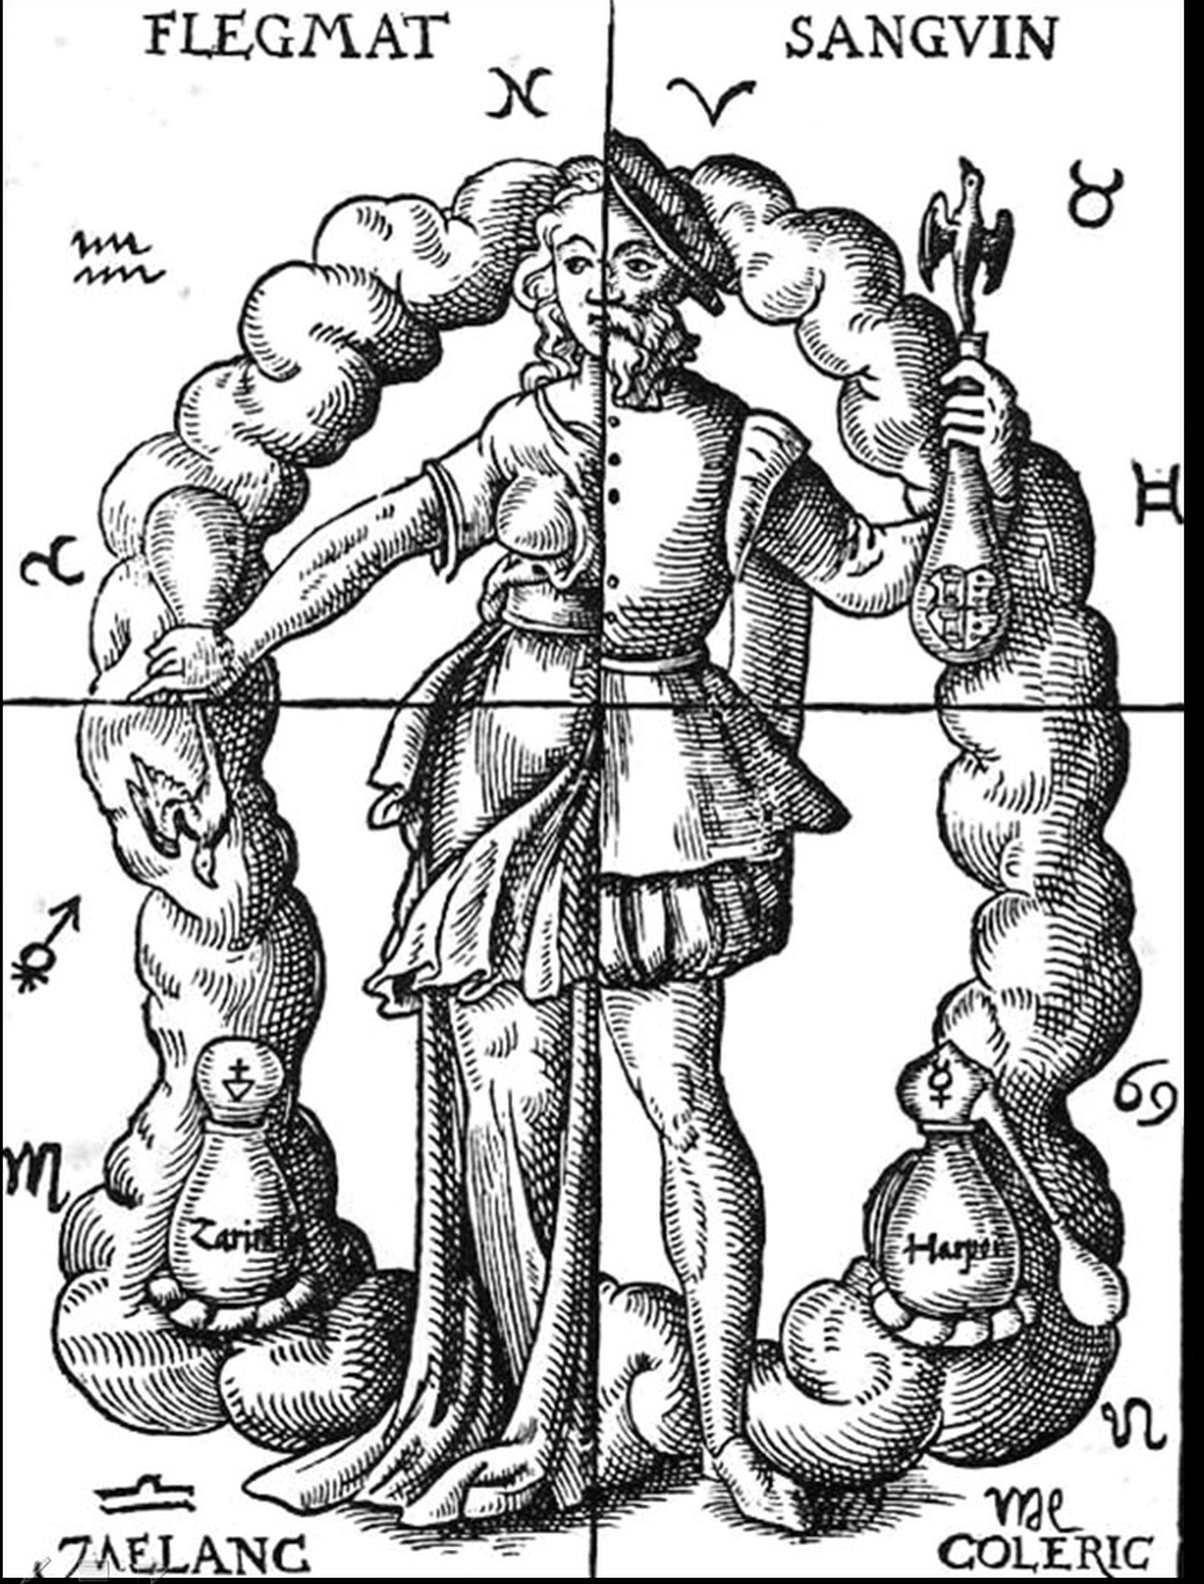
Belief 5:
The Four Humours

Slide 15
The Position of Mankind in the Universe
Man was seen as providing a link between matter and spirit.
His body was seen as a kind of microcosm and there were detailed resemblances seen between his body and the universe.
For example, in the same way that the universe was believed to be composed of the four elements, man’s body (and temperament) were believed to be composed of four humours.

Slide 16
The Four Humours
This is the term for the four fluids found within the body of man.
Melancholy = cold and dry (like earth)
Phlegm = cold and wet (like water)
Blood = warm and moist (like air)
Choler = warm and dry (like fire)
The balance of these fluids accounted for his personality, temperament and behaviour.
Watch out for imagery relating to both the four elements and the four humours in Richard II.

Slide 17
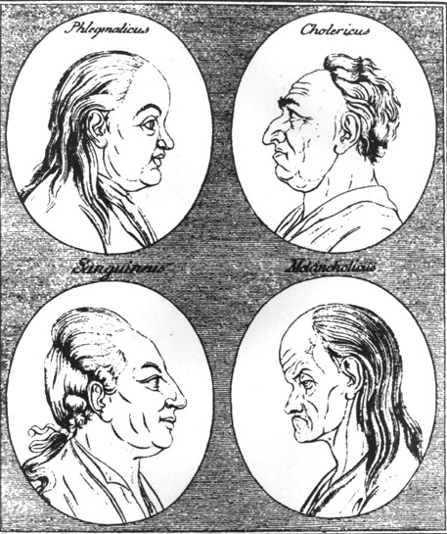
This illustration shows the ‘four temperaments’ which were believed to be influenced by the four humours.
Phlegmatic = relaxed and peaceful
Choleric = irritable and quick-tempered
Sanguine = optimistic, social and active
Melancholic = wise, analytical and quiet
We still use these terms today, although our understanding of biology is now much more sophisticated!

