Slide 1
AL English Literature Resource
The Real History Behind the Play

Slide 2
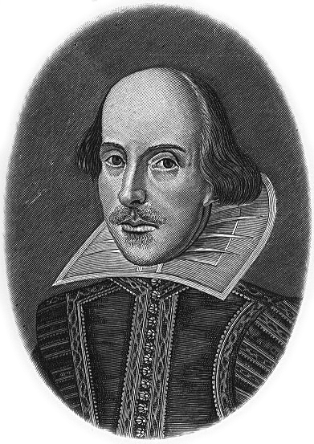
Key Contexts for Shakespeare’s Richard II Context 3: The Real History Behind the Play

Slide 3
Using Historical Context in Your Essays
You are not expected to write a history essay about the real events behind the play.
You do however need to have a basic understanding of them in order to pick up on the subtle themes, references and ideas that Shakespeare explores in the play.
As you read about key contexts in this slide show, you should think about how these relate to events in the play.
When using contextual factors in your essays, it is helpful to remember that your points should be:
Relevant
Often
Brief
Embedded

Slide 4
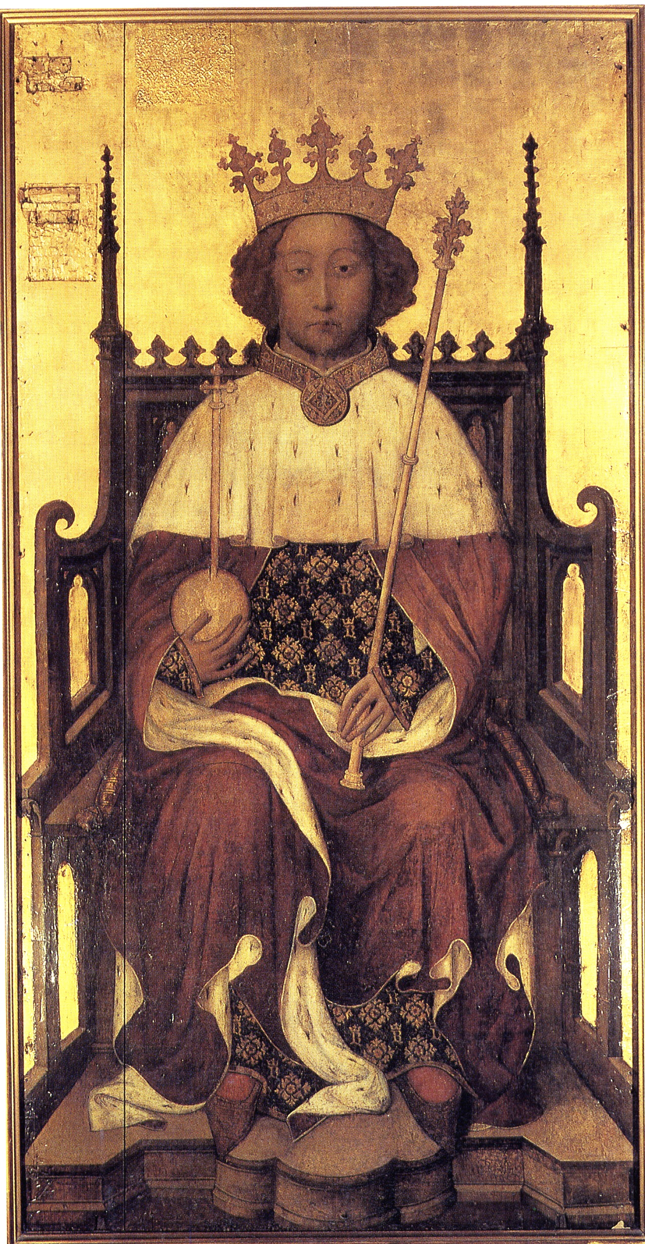
Richard II (1367-1400)
He ruled England from 1377-1399.
He was only 10 years old when he inherited the crown.
It passed directly to him from his grandfather, Edward III, as his own father, The Black Prince, died before Edward III.
Because Richard was so young at the start of his reign, the country was governed by a series of councils.
His uncle, John of Gaunt was also incredibly influential.

Slide 5
What was the Real Richard Like?
We know that he was attractive and tall, with long, golden hair.
He was an intelligent man, with many interests in culture and art.
Whereas his father and grandfather had been aggressive soldiers who fought for a claim to the French throne, this was not Richard’s style. He favoured peace.
Some say he was indecisive.
He made his court into a refined and elegant place, surrounding himself with art and culture, and he enjoyed luxurious foods and wine.
He had favourites in his court and alienated many influential nobles.

Slide 6
Shakespeare’s Sources
Remember that Shakespeare used ‘poetic licence’ in his history plays; first and foremost he was interested in a good piece of theatre, so the play is not an exact replica of history.
However, Shakespeare did make detailed use of his sources for the content of his history plays, and a lot of what happens in Richard II is based on real history.
The most significant source Shakespeare relied upon for the historical detail he included in Richard II was written by Raphael Holinshed.
Holinshed was an English Chronicler, given task of compiling history from the Flood to Elizabeth I.
He wrote Holinshed’s Chronicles of England, Scotland and Ireland published in two editions in 1577 and 1587.

Slide 7
How Did Shakespeare Use His Sources?
We know that the real Richard II was very similar to Shakespeare’s character.
Shakespeare kept the events of his reign in the same order.
BUT…
Shakespeare wanted to write a play which examined the notion of kingship, including the concept of the Divine Right of Kings and the responsibilities of monarchs.
To achieve this, he had to make some changes to the material in Holinshed’s Chronicles in order to bring these themes to the fore.
One of the biggest changes Shakespeare made was in his presentation of Richard’s uncle, John of Gaunt.

Slide 8
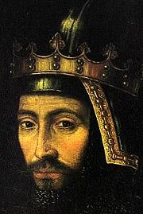
The Real John of Gaunt (1340-1399)
Gaunt was Richard’s uncle, the third son of Edward III. His son, Henry Bolingbroke, was the same age as Richard.
Gaunt was very influential in ruling England when Richard II was crowned, because Richard was only 10 years old.
Some people were suspicious of this and thought he wanted to seize the throne himself.
Gaunt was incredibly powerful and wealthy, but he was also unpopular as he taxed the people heavily during difficult times.
The eventual result of this heavy taxation was the Peasants’ Revolt.
Later in his career though, Gaunt did help to restore order and peace in England.

Slide 9
Shakespeare’s John of Gaunt
We know that the real John of Gaunt was greedy, aggressive and quite unpopular with the people of England.
In Richard II however, Shakespeare presents him as a wise, patriotic and honorable man who wishes to maintain peace and harmony in England at all costs.
He represents the values and traditions of the old world and speaks often of the importance of the Divine Right of Kings.
In the play, before his death, Gaunt tries, in vain, to warn Richard to use his power as monarch wisely and to look after England.
But although he knows Richard’s faults, Gaunt does not back his son against the King. He puts Richard’s divine status first and speaks out against rebellion and anarchy.
Whilst this is an example of ‘poetic licence’ used by Shakespeare to explore the theme of kingship, it is also likely that Shakespeare was mindful of the fact that Elizabeth I was a descendant of John of Gaunt!

Slide 10
The following slide contains a simplified version of the family tree which unites Richard II, Bolingbroke, John of Gaunt – and, around 200 years later – Elizabeth I.

Slide 11
Edward III
The Black Prince Lionel Edmund Blanche = John of Gaunt + Catherine Swinford
Richard II Philippa = Edmund Mortimer Henry IV Earl of Somerset
Roger Mortimer Henry V Duke of Somerset
Anne = Richard Queen Margaret = Henry VI Margaret Beaufort = Edmund Tudor
Richard Prince Edward Henry VII
Edward IV Edmund George Richard III The House of Lancaster
Henry VIII
Elizabeth Edward V Richard
Edward VI Mary I Elizabeth I
The House of York The House of Tudor

Slide 12
The Peasants’ Revolt (1381)
In 1381, the people rebelled against John of Gaunt’s government, in a movement known as the Peasants’ Revolt (although the people involved weren’t actually peasants).
Richard, aged only 14, went to Essex to meet the rebels and negotiated with Wat Tyler, their leader.
Wat Tyler was killed by the Lord Mayor of London but before the rebels could retaliate, Richard stepped in.
Richard told the rebels they could have what they wanted and, respecting him as their King, they listened to him.
Later though, he went back on his promises and had many of the ringleaders put to death. This made him very unpopular.

Slide 13
In a second meeting with the rebels, Richard addressed them much more harshly:
“You wretches, detestable on land and sea; you who seek equality with lords are unworthy to live. Give this message to your colleagues. Rustics you were and rustics you are still: you will remain in bondage not as before but incomparably harsher. For as long as we live we will strive to suppress you, and your misery will be an example in the eyes of posterity. However we will spare your lives if you remain faithful. Choose now which course you want to follow.”
From A History of Britain Volume One by Simon Schama

Slide 14
Was Richard a Megalomaniac?
Richard was a great believer in the Divine Right of Kings (sometimes also known as ‘divine ordination’).
He believed that as King, he was appointed by God, above ordinary people, and that he should be treated with great reverence.
He became obsessed with his own status, and surrounded himself with his own private guard when he ate, slept or travelled.
He was the first monarch to insist on being addressed as ‘highness’ and ‘majesty’.

Slide 15
This picture is known as the ‘Wilton Diptych’ and was painted around 1395-99. It depicts Richard alongside St Edmund, Edward the Confessor and St John the Baptist in one portrait, addressing the Virgin Mary and the choir of angels.

Slide 16
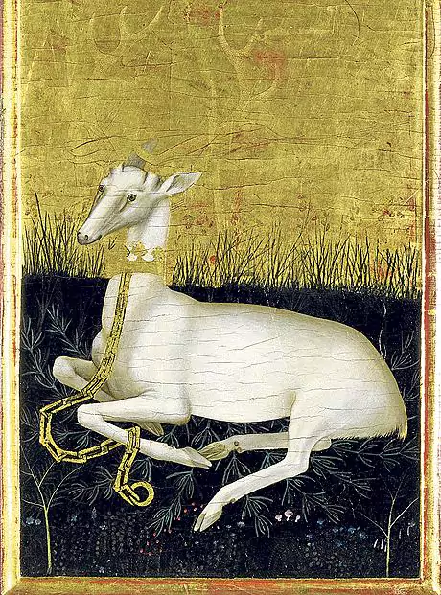
The White Hart was Richard II’s emblem

Slide 17
“The first self-conscious designer of a royal identity, Richard understood as none of his predecessors had done that ceremony was not just the dressing of royalty; it was at the heart of its mystery and the secret of its power to make men obey.”
From A History of Britain Volume One by Simon Schama

Slide 18
The Lords’ Appellants Rebellion (1387)
This was a rebellion led by a group of nobles against Richard. They were unhappy that Richard had a small number of favourites with whose help they believed he was ruling tyrannically.
The rebels included Thomas of Woodstock, Duke of Gloucester (another of Richard’s uncles) and later Henry Bolingbroke and Thomas de Mowbray.
They established a commission to govern England for one year, from 1386. They then rebelled against the King and defeated his army near Oxford.
In 1388, they carried out the Merciless Parliament, where they punished Richard’s favourites, either by sentencing them to death or confiscating all their possessions and wealth.

Slide 19
The Aftermath of the Lords’ Appellants Rebellion
Richard was able to return to power only when John of Gaunt returned from Spain. In 1397, he reasserted himself and destroyed the principal three among the Lords Appellant.
He never forgave them though and it is believed he had his uncle Gloucester (one of the rebels) killed. Others lost their titles and lands. Interestingly, Richard did not punish Bolingbroke or Mowbray when he regained power.
Their behaviour however, probably influenced Richard’s decision in 1399 to exile them both.
It is this decision to exile Mowbray and Bolingbroke that takes place in Act I, Scene III of the play.

Slide 20
Richard Versus Bolingbroke
Richard and Bolingbroke were cousins of the same age and played together as children.
Bolingbroke was part of the Lords Appellants’ Rebellion (1387).
Once Richard regained power, he chose not to punish Bolingbroke.
In 1398, Bolingbroke was accused of treason by the 1st Duke of Norfolk, Thomas de Mowbray. Richard II called a duel to settle the dispute.
But before the duel could happen, Richard banished Bolingbroke and exiled Mowbray for life.
When John of Gaunt died in 1399, Richard made sure Bolingbroke would not inherit his father’s lands automatically. Instead, he would have to ask for Richard’s permission.
Bolingbroke’s revenge was to gather an army and form a military campaign to depose Richard as King.

Slide 21
Forced Abdication
Bolingbroke gained enough support in England to declare himself King Henry IV.
Richard was kept as a prisoner in the Tower of London and was asked to abdicate three times, but refused each time.
Richard eventually accepted the inevitable and his title was adjusted to ‘Sir Richard of Bordeaux’.
Bolingbroke was officially crowned King Henry IV in 1399.
Richard died, aged 33, imprisoned in Pontefract Castle in Yorkshire. The cause of his death seems to have been starvation, but historians are unsure whether this was self-imposed or forced upon him.
Rumours he was still alive persisted into reign of Henry V (Bolingbroke’s son).

Slide 22
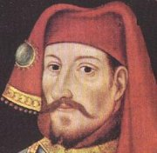
The Real Bolingbroke (1367-1413)
Bolingbroke argued that he had an obscure claim to the throne as a descendant of Henry III’s son.
It is thought that he deliberately starved Richard to death to avoid signs of any incriminating marks on his body.
When Bolingbroke finally became King Henry IV, ironically he too was plagued by rebellions, plots and assassination attempts.
Shakespeare depicts him as a paranoid and unhappy tyrant in Henry IV (Parts I and II).

Slide 23
Perceptions of Richard II
Our perceptions of King Richard II have been influenced by Shakespeare’s portrayal of him.
However, in some ways, the play suggests that his poor leadership and deposition led to the Wars of the Roses, a lengthy period of Civil War, later on. This is not what historians now believe.
Most historians agree that although Richard II’s policies were not unusual, the way he carried them out was unacceptable to the political establishment of the time.

