Slide 1
AL English Literature Resource
Elizabethan Society

Slide 2
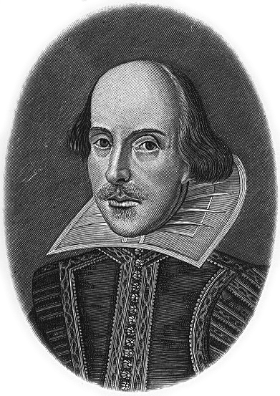
Key Contexts for Shakespeare’s Richard II Context 1 – Elizabethan Society: Social Class and Gender

Slide 3
Richard II and the Elizabethan World
Richard II was written early in Shakespeare’s career, circa 1595. It was first performed in 1601.
This was during the reign of Queen Elizabeth I, so we can therefore refer to the play as Elizabethan.
It is important that you have some sense of how Elizabethan society operated and its values in order to understand how key themes, characters and ideas in the play would be received by the audience of Shakespeare’s day.
This kind of historical, social and cultural context provides important background for your essays on the play.

Slide 4
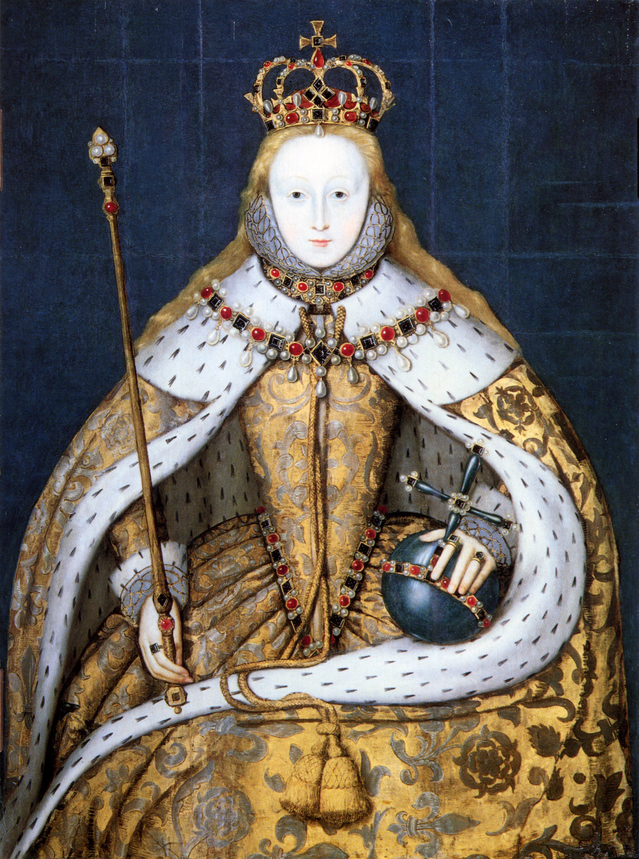
Elizabeth I
Elizabeth I reigned in England from 1558 to 1603.
She was the daughter of Tudor King, Henry VIII and his second wife, Anne Boleyn.
She was a Protestant.
She did not marry or have children during her reign, so she was the last monarch of the Tudor dynasty.
She was also sometimes referred to as ‘Gloriana’, ‘The Virgin Queen’ and ‘Good Queen Bess’.

Slide 5
Social Class in Elizabethan England
Elizabethan society can loosely be divided into the following layers or ‘classes’:
Aristocracy (or nobility)
Gentry
Citizens
Yeomen
Servants, Labourers or Peasants
The Poor

Slide 6
Aristocracy (or nobility)
People of noble birth who owned large country estates and who often also held positions at court and in Parliament.
Gentry
Descendants of the aristocracy whose estates were smaller but who still owned considerable wealth.
People who had amassed wealth through trade and commerce and were known as ‘gentlemen’.
Citizens
Mainly composed of shopkeepers and urban tradesmen, who either made goods or sold them.
Yeomen
People who lived in the country, who owned agricultural or grazing lands (from which some may earn a very good living).
Servants, Labourers or Peasants
People who owned very little and who earned wages working for others.
The Poor
Those who could not work.

Slide 7
The Social Hierarchy
Aristocrats were born into money and inherited land and titles from their ancestors.
This power, land and wealth meant that they controlled much of society.
By contrast, life was relatively hard for those at the bottom of the social hierarchy.
In theory, it was seen as the duty of the aristocracy to behave charitably towards their social inferiors, but this was not always the case.
Social conditioning mostly kept people in their ‘places’ as well as the lack of easy geographical mobility for most poorer people.

Slide 8
Social Mobility
Although opportunities were much less common than today, there were some possibilities for social advancement in Elizabethan society.
The growth of trade and the development of skilled professions meant that some ordinary people could become wealthier and more powerful.
Apprenticeships and more widely available education also helped to reduce the barriers between the social classes.
Shakespeare himself benefitted from the money he earned in the theatre and moved into the lower ranks of the aristocracy. He even secured a coat of arms for his family.

Slide 9
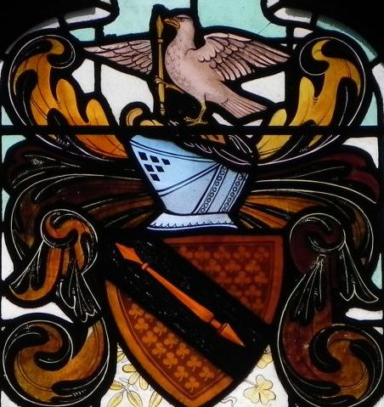
This is a picture of Shakespeare’s coat of arms depicted in stained glass in the Royal Shakespeare Theatre.
This is a picture of Shakespeare’s coat of arms depicted in stained glass in the Royal Shakespeare Theatre.

Slide 10
Attitudes to Social Mobility
The aristocracy were not very keen on people in the lower classes moving up the social ladder. They had a position of power to protect and social mobility threatened this.
There was growing concern in the late sixteenth and early seventeenth centuries that the divisions between rich and poor were not clear enough.
Elizabeth I and her government even promoted harsh laws of apprenticeship and fashion, restricting certain materials and styles of dress to the aristocracy only. These were known as the Sumptuary Laws.
You don’t have to know specific details of these laws for the exams, but you should understand how important the concept of knowing one’s place was in Elizabethan England, because this is a key them of Richard II and its exploration would have resonated with the audiences of Shakespeare’s time.

Slide 11
Women in Elizabethan England
Despite the country being ruled by a woman, women were very much second-class citizens in Elizabethan society.
Their legal status restricted them in terms of public and private power.
Women were often poorly educated.
They were seen as being less rational as men, and therefore as needing their protection.
Men controlled society as well as being the heads of their families. Elizabethan society was therefore patriarchal.
This structure reflected the Great Chain of Being – a hierarchical structure which was seen to apply to all elements in the universe.

Slide 12
The Patriarchal Household
‘Patriarchy’ in Shakespeare’s lifetime referred to the power the father held over his household.
This included his wife and his children, but also any servants.
The father was seen as similar to the King, and his household was his ‘state’.
A well-ordered household should therefore be run like a well-ordered state and achieving this was seen as a way to maintain harmony.

Slide 13
Inheritance
Primogeniture meant that inheritance was passed from oldest son to oldest son.
Women did not therefore usually inherit their family’s titles, land or wealth, except in unusual cases where there was no male heir.
This applies to Elizabeth I herself, who inherited the crown because her brother, and then later her older sister, both died without children.

Slide 14
Women and Marriage
When women got married, they lost most of their limited legal rights.
They became the property of their husbands, and anything they had inherited from their own family passed to their husbands.
Marriage was important for women though; if they did not marry, then they would continue to be an ongoing expense for their father.
Elizabeth I never married and it is likely that if she had, she too would have lost a lot of her power and authority to her husband.

Slide 15
Work and Education for Women
Women received very little in the way of education.
They were not allowed to enter certain professions, including acting (which is why boys were used to play the parts of women on stage in Shakespeare’s lifetime).
Women’s primary roles were as wife and mother.
Society very much restricted women to the domestic sphere.
They were responsible for the day-to-day running of their homes. Wealthier women would have help from servants for this, but poorer women would do the physical work around the house themselves and this was an all-consuming job.

Slide 16
Gender Roles: Women
Women were expected to conform to what the critic Valerie Traub refers to as ‘four virtues’:
Obedience
Chastity
Silence
Piety
As marriage and motherhood were expected of women, it was also desirable for them to be young and attractive, to increase their chances of both marriage and conception.

Slide 17
The Four Virtues: Obedience
Women were seen initially as the property of their fathers, and then when they married, the property of their husbands.
They were expected to be obedient to the men in their lives. Disobedience from women could be seen as interrupting the natural order of society in terms of the Great Chain of Being (where women were inferior to men in the hierarchy).
Men were legally allowed to discipline and punish their wives.
However some women did have some power within their own households. They were often responsible for overseeing the domestic servants and for educating their children.

Slide 18
The Four Virtues: Chastity
Elizabethan women were expected to be chaste.
Sex before marriage (fornication) was a sin and so single women were expected to be virgins on their wedding day.
For married women, chastity refers to being monogamous and faithful to their husbands. Sex outside of marriage (adultery) was also a sin.
Although technically the same applied to men, promiscuity in men was not judged as harshly as it was in women.
Women of course could end up becoming pregnant as a consequence of pre-marital sex, so it would be much harder for them to conceal their sexual activity.

Slide 19
The Four Virtues: Silence
In the sixteenth century, silence was a virtue highly prized in women, and women of the lower classes could be publicly humiliated and punished for talking too much or ‘scolding’ their husbands.
Women who talked too much were known as ‘shrews’ or ‘scolds’. In extreme cases, they could even be made to wear a scold’s bridle or branks. This was a piece of iron headgear that fitted over the head and face and had a spike which protruded into the mouth to hold the tongue down and prevent speaking.
Women were not expected to be silent at all times of course, but they were not expected to be opinionated, outspoken or to have as much to say as men.

Slide 20
The Four Virtues: Piety
Piety, or devotion to God, was expected from everyone as Shakespeare was writing at a time when everybody in Britain practised religion and attended Church regularly.
Religious teachings and the Bible therefore had a significant impact on expectations for women’s behaviour.
The Virgin Mary was one iconic figure who influenced attitudes towards women, as she was the ultimate example of a pure, nurturing and maternal figure.
Eve was another extreme - her actions led to the ejection of the human race from Paradise. She was weak because she was tempted by the Serpent to eat the forbidden fruit, and she was cunning because she then tempted Adam to do the same.

Slide 21
Elizabeth I: A Female King?
It may seem surprising that women in Elizabethan society had so few rights, when they had a queen ruling the country.
However, Elizabeth I only became monarch (after her sister Mary I) because her brother, Edward VI, died young and without heirs.
She herself fought hard to rule as a woman, and famously referred to herself as ‘a King’.
If she had married, she too would have lost much of her power.
Her unmarried status meant that she was idealised and referred to by some as ‘the Virgin Queen’.

Slide 22
“I know I have the body of a weak and feeble woman, but I have the heart and stomach of a king, and of a king of England too…”
An extract from Elizabeth I’s speech delivered after the defeat of the Spanish Armada in 1588

