Slide 1
Lower Secondary
Year 7 Science Resource
Tips for Investigations

Slide 2
Variables
We do investigations to find the answers to different questions, particularly about how one thing affects another thing.
We consider how the independent variable affects the dependent variable.
We must also control all other variables (things that might change) so that we’re only looking at the effect of one thing. We do this by keeping this variable the same the whole time.

Slide 3
For example
‘I investigated how the amount of sunlight a plant gets affected how tall it grows’
Independent variable = amount of sunlight. You can restrict this by keeping one plant inside and one outside, for example.
Dependent variable= change in height of the plants. We expect this to change because of the sunlight.
Control variables = what else could affect plant growth? Things like amount of water we give them, amount of soil they get – we should try to keep these constant as much as we can.

Slide 4
Another example for you to try
‘I investigated how the mass of chocolate eaten affects heart rate’
Independent variable =
the mass of chocolate.
You could eat 1, 10 or 50 squares!
Dependent variable =
heart rate.
Control variables =
type of chocolate.
But other things could affect heart rate, like whether we have just
drunk coffee, run, the time of day, age of person eating it
- we should try to keep these constant as much as we can.

Slide 5
Summary
Variables – a value that has the potential to change (e.g. temperature).
In an experiment you usually change one variable and measure how it affects another variable:
Independent variable – the variable that you choose to change so that it will change something else. You usually decide on the values at the start of the experiment.
Dependent variable – the one you measure, not the one you set. It changes because of the independent variable.
Control variable – ones that you keep the same.

Slide 6
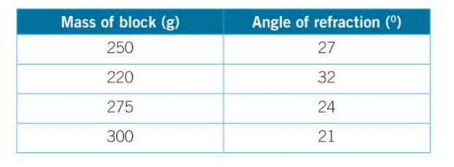
Tables
The independent variable goes in the far left column (the mass of the block is being changed).
In this case the dependent variable is the ‘angle of reflection’ which is being measured.
Add the headings for each column.
Make sure you use a specific measurement – mass, volume, percentage etc.
Put the units for this measurement, only in the heading of the table, not after every value. (In the table above the units are grams, g; and degrees,°)

Slide 7
More on tables
You might do the experiment at least three times to make your answer more reliable. If you do that, you can split the column for your dependent variable into more columns, (as in the table above) and then have a mean or average column afterwards.

Slide 8
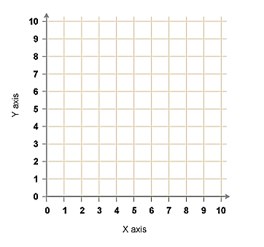
Drawing graphs
X to the left
Y to the sky
If the independent variable (which always goes on the
x axis) has distinct categories – e.g. animal types or
type of metal = BAR CHART
If the independent variable is continuous (can take any value in a range)
e.g. temperature, time, length = LINE GRAPH
Make sure you choose a scale that takes up as much of the space as possible. For example, if you use 1 square = 1cm, and there is loads of space unused, consider using 2 squares = 1cm instead.
Remember to label your axes and include units.
Use a sharp pencil when plotting points and make a neat cross not a dot.
X

Slide 9
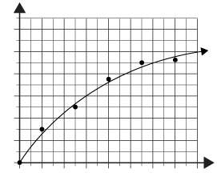
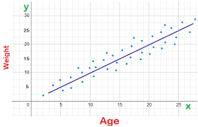
Line of Best Fit
If you are drawing a line graph, do not join the dots, instead,
use a line of best fit.
If the points you have plotted look pretty straight, draw a straight line through them with a ruler. If they look like they curve together, draw a curve.
You don’t have to go through all the points with your line of best fit, just go through the middle. Try to get an equal number of points on each side of the line.
Ignore any anomalous results –
(strange results that do not seem to fit in with the general
pattern found in the data).

Slide 10
Reliable and valid results
Reliable results are from experiments that produce similar data
Repeating experiments and calculating the mean after you have discarded anomalous results increases the reliability.
Do at least 3 repeats.
Valid results are both reliable and come from controlling the variables in an experiment.
Repeatable – the same person can get the same results using the same equipment and method.
Reproducible – If another person can get the same result (trend or specific) using the same method and equipment.

Slide 11
Accuracy vs Precision

Slide 12
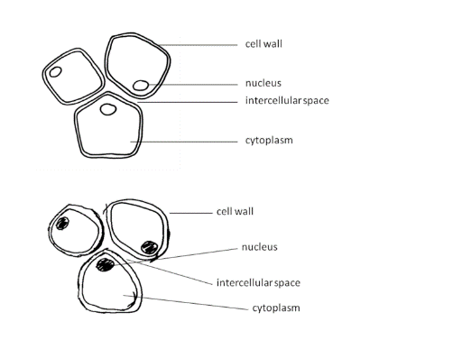
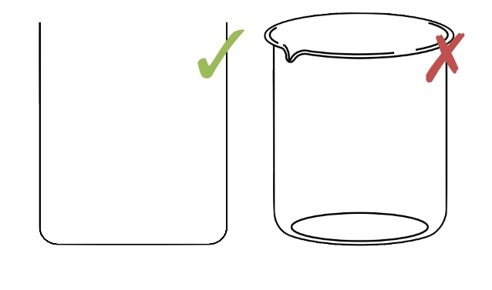
Scientific Diagrams
Good
Use a sharp pencil.
Use a ruler to draw straight lines.
Make it neat.
No shading or fancy artwork.
Make it large.
Draw 2 dimensional representations.
Label clearly and do not cross your label lines.
Bad

Slide 13
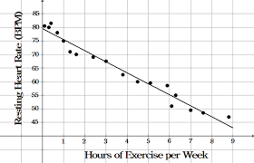
Analysing results
This goes for looking at your own results or a graph you’ve been given.
When you’re describing a relationship between two variables, try to use the following format:
When [independent variable] increases, the [dependent variable] increases/decreases
For example, for the graph above we would say ‘as the hours of exercise per week increase, the rising heart rate decreases’
We can look at the experiment and say what went wrong – was it reliable and valid?
Sometimes you are asked to make a prediction at the start of a practical – you can use the same format for what you think will happen too.

